Slide 1
Introduction to BI Architecture
Professor: Steve Conrad

Slide 2
DW/BI Goals - Commentary
“We collect tons of data, but we can’t access it.”
“We need to slice and dice the data every which way.”
“Business people need to get at the data easily.”
“Just show me what is important.”
“We spend entire meetings arguing about who has the right numbers rather
than making decisions.”
“We want people to use information to support more fact-based decision
making.”
Source: The Data Warehouse Toolkit 3rd Edition, Kimball, Ross - Wiley, 2013

Slide 3
DW/BI Goals – Business Requirements
The DW/BI system must make information easily accessible.
The DW/BI system must present information consistently.
The DW/BI system must adapt to change.
The DW/BI system must present information in a timely way.
The DW/BI system must be a secure bastion that protects the information assets.
The DW/BI system must serve as the authoritative and trustworthy foundation for improved decision making.
The business community must accept the DW/BI system to deem it successful.
Source: The Data Warehouse Toolkit 3rd Edition, Kimball, Ross - Wiley, 2013

Slide 4
What is BI Architecture?
Class Definition
A framework that…
  Organizes BI components
  Contains BI tools to perform analytics
  Contains data for analytics
  Provides for the flow from source to presentation using various ETL processes.

Slide 5
What is BI Architecture?
According to Kimball
The Kimball technical system architecture separates the data and processes comprising the DW/BI system into the backroom extract, transformation and load (ETL) environment and the front room presentation area
The Kimball technical system architecture focuses on the following components:
  Backroom ETL system: The Kimball Group has identified 34 subsystems in the ETL process flow, grouped into four major operations: extracting the data from the sources, performing cleansing and conforming transformations, delivering it to the presentation server, and managing the ETL process and back room environment.
  Front room presentation area: The Kimball Architecture presumes the data utilized by the BI applications is dimensionally-structured, organized by business process, atomically-grained (complemented by aggregated summaries for performance tuning), and tied together by the enterprise data warehouse bus architecture, as described earlier on this page.
  Front room BI applications: The front room is the public face of the DW/BI system; it’s what business users see and work with day-to-day. There’s a broad range of BI applications supported by BI management services in the front room, including ad hoc queries, standardized reports, dashboards and scorecards, and more powerful analytic or mining/modeling applications.
  Metadata: Metadata is all the information that defines and describes the structures, operations, and contents of the DW/BI system. Technical metadata defines the objects and processes which comprise the DW/BI system. Business metadata describes the data warehouse contents in user terms, including what data is available, where did it come from, what does it mean, and how does it relate to other data. Finally, process metadata describes the warehouse’s operational results.
Source: The Data Warehouse Toolkit 3rd Edition, Kimball, Ross - Wiley, 2013

Slide 6
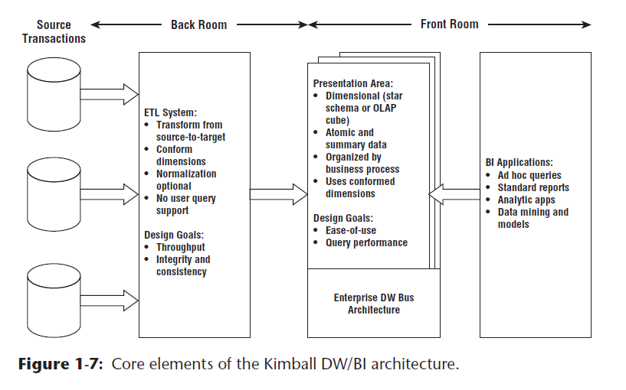
Architecture – Kimball
Source: The Data Warehouse Toolkit 3rd Edition, Kimball, Ross - Wiley, 2013

Slide 7
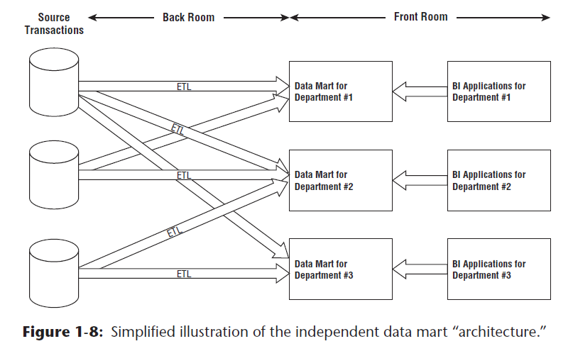
Architecture – Independent Data Mart
Source: The Data Warehouse Toolkit 3rd Edition, Kimball, Ross - Wiley, 2013

Slide 8
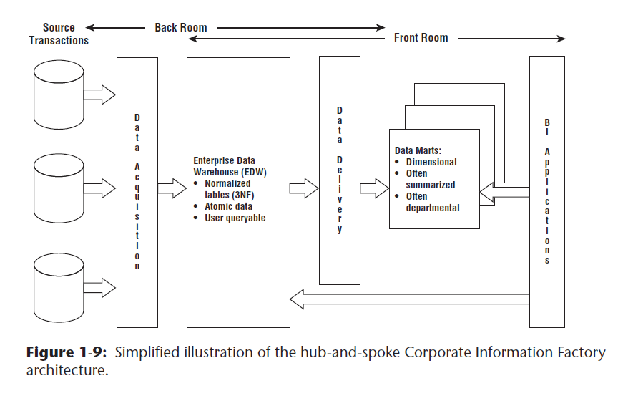
Architecture – CIF (Inmon)
Source: The Data Warehouse Toolkit 3rd Edition, Kimball, Ross - Wiley, 2013

Slide 9
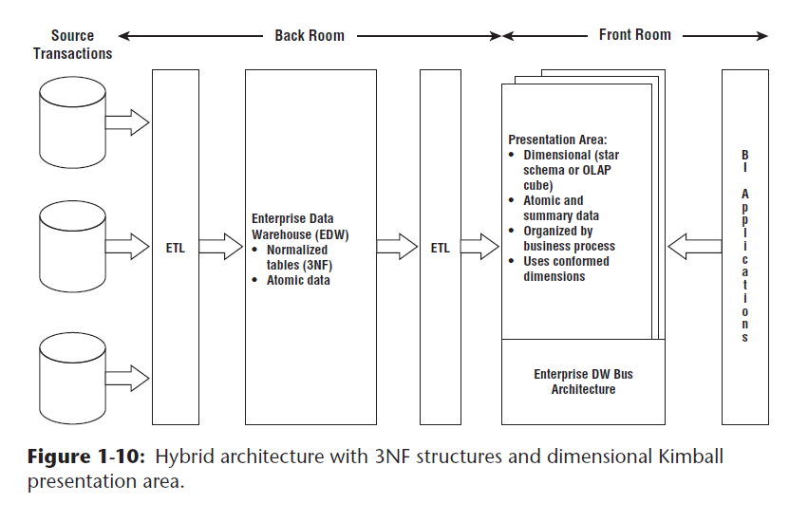
Architecture – Hybrid
Source: The Data Warehouse Toolkit 3rd Edition, Kimball, Ross - Wiley, 2013

Slide 10
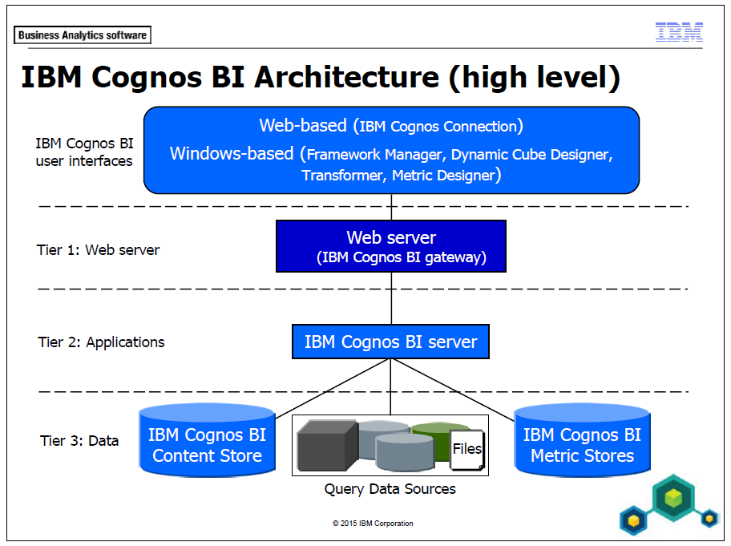

Slide 11
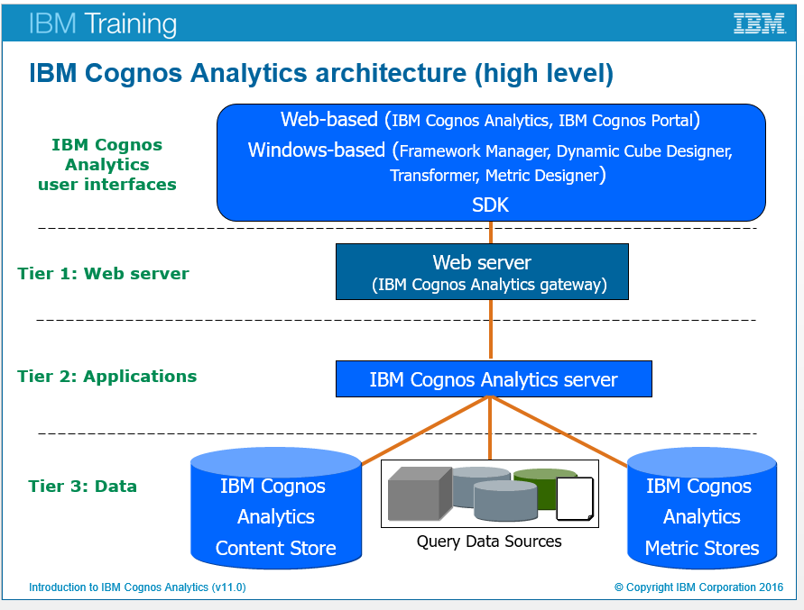

Slide 12
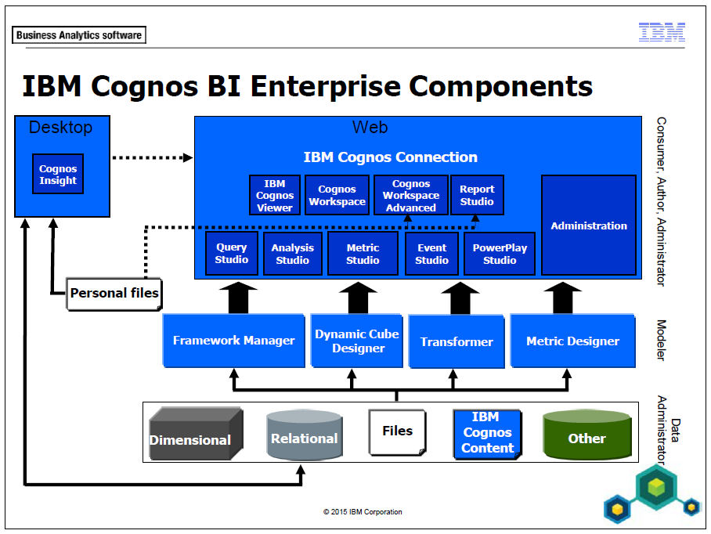

Slide 13
